Slide 1
Sentiment Analysis of Yelp Reviews
By: Truett Bloxsom, Kevin Brill, Thomas Bruce, Eddie Eustachon, and Matthew Zlotnik

Slide 2
What’s to come
Goals of project
Data sets used in analysis
Predicting review ratings (number of stars)
Business outcomes
Conclusion

Slide 3
Goals:
Do the emotions of a review predict the rating?
Can these emotional scores help companies with customer service?
What can businesses learn from reviews?

Slide 4
Data Used
Subset of the Yelp reviews dataset on Kaggle (6.7 million reviews)
Emotions dictionary dataset (with scores for fear, happy, sad, anger, neutral, surprise, disgust)
Emotionally scored Yelp reviews

Slide 5
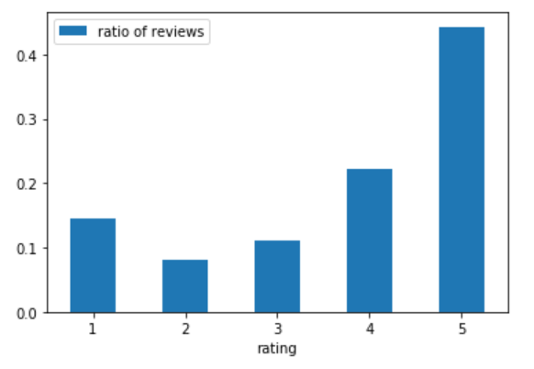
EDA - Yelp Reviews
Original size 5GB
Randomly selected 100,000 reviews
Has the review, rating of review (1 to 5 stars), and tags (funny, cool, useful)
44% are 5-star reviews

Slide 6
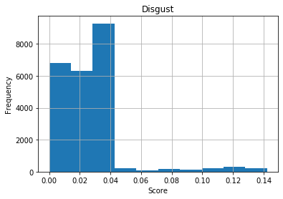
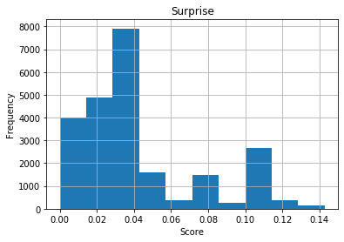
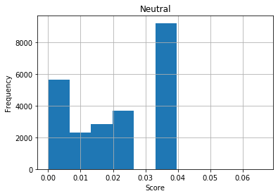
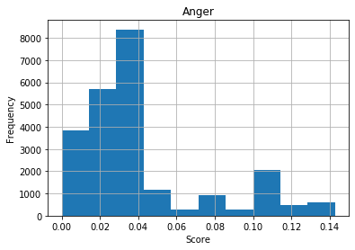
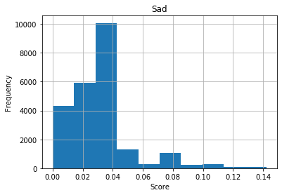
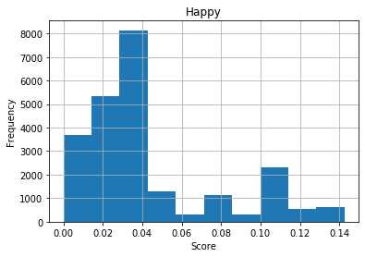
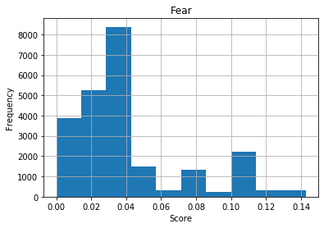
EDA - Emotions Dictionary

Slide 7
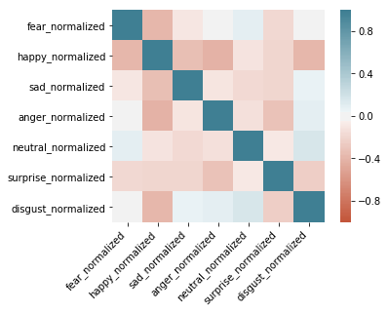
EDA - Emotions Dictionary

Slide 8
EDA - Emotionally Scored Yelp Reviews
Aggregated emotional scores of each word in review
Normalized scores based on total scores
Computationally expensive!
O(knm)
k = number of words in emotions dataset
n = number of reviews
m = number of words in reviews
Notes:
So to create our emotionally scored yelp reviews dataset, we had to loop through the each word of the review, check if it was in the emotions dictionary dataset and then add up all the emotional scores for said review. So we would have a score for each emotion for each review. This was extremely computationally expensive and took us hours to just score a 1000 reviews. We then normalized the scores so to put all the emotions on the same scale since emotions like nuetral were much more common than surpise.

Slide 9
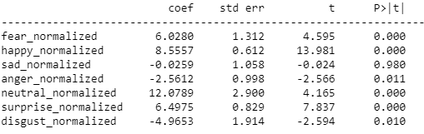
Linear Regression on Emotion Scores
R-squared: 0.218
RMSE: 1.217 stars
Notes:
Here is the output when we ran linear regression on emotional scores trying to predict rating. All of the coefficients are significant at the 5% level and just through intuition the coefficients seem reasonable. For example, Happy has a positive effect on ratings and and and disgust have a negative effect. But interestingly sad has only a slightly negative coefficient. Looking at the R squared is not promising. The emotions only explain 21% of the variance in ratings and the RMSE is quite large. Plus MLR warned us that there might be collinearity between variables. But MLR is not the best model to use for multi-classification problems so let's move on to some more applicable models.

Slide 10
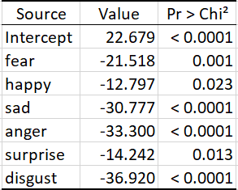
Predicting Rating Based on Emotional Score
Logit Regression
Binary Output:
1, 2, and 3 stars = 0
4 and 5 stars = 1
Multi-logit Regression Accuracy: 45.33%
Notes:
We first tried logistic regression and created a binary output for rating so it could be more interpretable. Looking at the logistic output, all the emotions are once again significant at the 5% level but all of the values are negative.
The odds ratio can be calculated by exponentiating the coefficient values to get basically 0 for all of them which means we expect to see almost not change in the odds of being in a good rating, for a one-unit increase in happy score. This is a troubling output and looking at the multi-logit accuracy it barely imporved from our baseline of 44%. Lets try some other models.

Slide 11
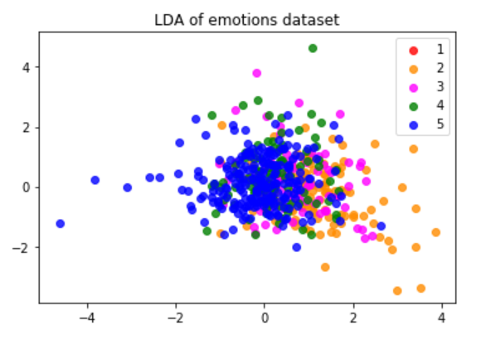
Ensemble Methods and Linear Discriminant Analysis
Random Forest Classifier, SVC, and Logistics Regression
Ensemble Method Accuracy: 46.33%
Linear Discriminant Analysis Accuracy: 49%
Notes:
We went on to try an ensemble method which included Random forest classifier, Support Vector Classifier, and logistics regression and it did not improve our accuracy. We tried a whole host of models and our best one was using LDA, linear discriminant analysis with an accuracy of 49%. LDA like while running MLR warned us of collinearity problems. The plot shown is the first 2 LDA components from the dataset. LDA is like a supervised version of PCA. As you may see there is almost no separation between the 5 ratings which further hurts our hopes of the emotional scored yelp reviews dataset being a good predictor of ratings.

Slide 12
Why was prediction accuracy so low?
Notes:
One thing is the emotions dataset may have been created inaccurately. Another possible answer is that emotions just don't solely explain a lot about rating as shown in the previous slide with the LDA plot. It might be that it is much harder than we think to predict rating but we did not give up! So ill hand it over to thomas who will show a new approach to the problem.

Slide 13
New Approach
Sample of 10,000 reviews
Bag of Words:
Tokenize
Lemmatize
Remove stop words
Models to try:
SVM
Lasso
Topic Modeling
Notes:
We decided to scrap the emotions dataset and try a new approach with a bag of words model. The idea behind this is that rather than performing a sentiment analysis on the reviews, we use the words themselves to try to predict ratings.

Slide 14
SVM
Accuracy of 53.3%
Optimal parameters:
N_components = 150
Max_df = 0.75
Cost = 50
Positive takeaway:
Improvement over emotional scores
Business downside:
SVM is not very interpretable for text analysis

Slide 15
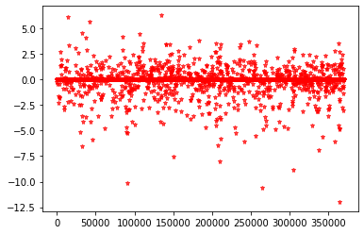
Lasso
61.2% accuracy predicting ratings with single words and bigrams
Optimal parameters:
λ = 0.0001
Max_df = 0.75
Lasso Coefficients
Notes:
Notice that most coefficients are close to (or equal to) zero, meaning that a lot of words have no predictive power. Negative coefficients seem to be bigger, meaning there are words that strongly predict negative reviews. We will figure out what words these are in a minute.

Slide 16
Lasso
Unigrams and bigrams have most predictive power
Unigrams have highest coefficients in model
Trigrams give better business insights
Notes:
The model with the best accuracy (about 61%) used unigrams (single words) and bigrams (two-word phrases). Single words had the highest coefficients (most of the coefficients with a large magnitude on the previous slide were unigrams). However, as we’ll discuss later, coefficients of trigrams can give good business insights, even if the model doesn’t have as good predictive accuracy.

Slide 17
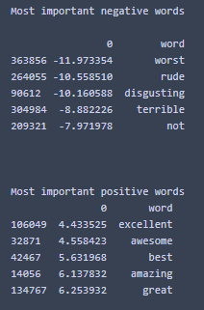
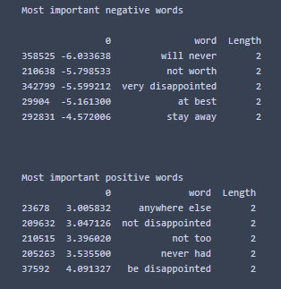
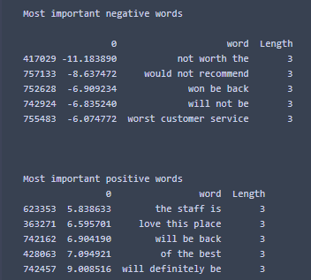
Lasso
Unigrams
Bigrams
Trigrams
Notes:
Note that the coefficients of unigrams were larger than the coefficient for bigrams (trigram coef magnitudes are irrelevant since they came from a different and less accurate model). Disappointment shows up in both good and bad reviews (depending on the phrasing), so this suggests that customer expectations play a very large role in how the review the business.

Slide 18
Topic Modeling
Latent Dirichlet Allocation to create topics out of our bag-of-words
Topics used as features in a Random Forest
Optimal parameters
Max_depth = 10
Min_samples_split = 50
N_estimators (trees) = 90
N_topics = 10
Best accuracy: 42.3%

Slide 19
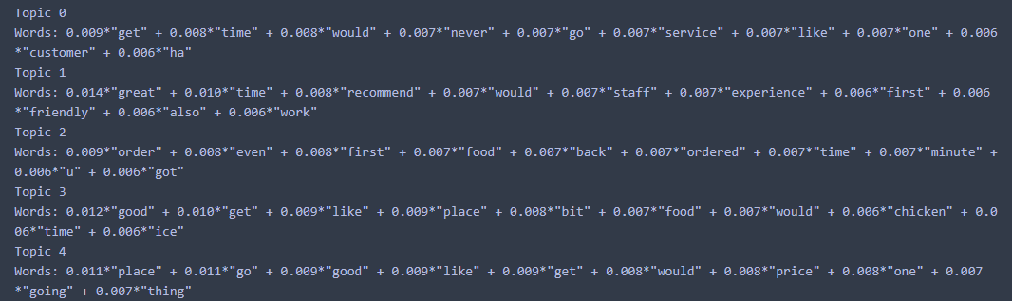
Topics Found

Slide 20
Other Topic Modeling Approaches
Create TF-IDF vector out of the bag of words
TF-IDF accounts for frequent and infrequent words
Try other models with either LDA approach
Pre-process the text differently
Some reviews were about services; some reviews weren’t English
Notes:
As Eddie mentioned, the predictive power of the random forest model we trained using XGBoost and having the LDA outputs as inputs was not effective in creating a regression model to predict the stars of a review. However, we identified some possible methods which could have been more effective. One possible alternative would be to create TF-IDF vectors out of the reviews instead of Bag-of-words vectors. This might have allowed us to isolate the more descriptive words like “service, food, chicken, or price” and give less importance to the more frequently occurring words such as “time, would, and recommend”. Another approach we could have employed would have been to change our idea of the LDA problem from regression to classification. Using 1, 2, and 3 as a negative classification, and 4 and 5 as positive would allow us to employ logistic regression and other classification techniques, which could have improved the accuracy of our model. Finally, given the diversity of the data in our Yelp Reviews data set, we could have approached pre-processing in many different ways, including trying to separate restaurants from services or translating all text to English.

Slide 21
Marketing Insights
Predicting based off emotion is difficult
Customer-Staff interactions are important predictors of ratings
Understand customer expectations
Many negative reviews mention “disappointment”
Major topics that customers write about are:
Quality of service
Speed of service
Quality of food
Pricing
Notes:
Even though were ultimately unsuccessful in predicting ratings through our methods, there are still marketing insights to be gleaned from this analysis. Firstly, and not to be undervalued, predicting based off emotions is difficult as Emotional scoring itself is an intensive and difficult process. Just because a review says “I hate how often I go here”, doesn’t mean that its a bad review. Secondly, our Latent Dirichlet Allocation did reveal that the most frequently occurring topics in the reviews were customer-staff interactions. As such, employing a well-trained and friendly work force should be prioritized in trying to please customers. Additionally, many of the negative reviews mention the consumer’s disappointment with the establishment. Our key takeaway from this is that businesses should carefully monitor positive reviews on their Yelps and ensure that they are familiar with expectations on their goods or services. If customers all say that the fried chicken is amazing, the restaurant should ensure that their fried chicken is made consistently well, as not to disappoint individual patrons. Also, though it may come as no surprise, the vast majority of topics in our Latent Dirichlet Allocation concerned those topics listed. One major omission from this list is ambience, which seemingly creates less positive or negative reviews than these other topics.

Slide 22
What more could be done with this analysis?
A/B testing with sales data
Limit scope to a single sector/business
Combine emotions dataset with Latent Dirichlet Allocation.
Notes:
Finally, we identified a few ways our analysis could be extended to possibly increase predictive power and insights, including acquiring and conducting A/B tests on sales data. One of the key issues with our analysis is that the stars of a yelp review are often extremely subjective, and sales data could help remedy this subjectivity. In line with our thoughts on preprocessing for LDA, we could limit the scope to a single sector/business/geographic region and see if consumers of a particular area of interest exhibit different/more easily identifiable patterns than the greater data set as a whole. Finally, one complex analysis we contemplated using was stacking our emotions/emotional scoring with our Latent Dirichlet Allocation to create a topic/emotion combined scoring and see if this could be more predictive. As our emotional scoring was extremely computationally costly, this analysis was out of the reasonable scope of this project. Any questions?

Slide 23
Appendix
Yelp dataset : https://www.kaggle.com/yelp-dataset/yelp-dataset
Github with other datasets and code: https://github.com/tsbloxsom/Marketing-Analytics/tree/master/Yelp%20Emotions%20Project

Slide 24
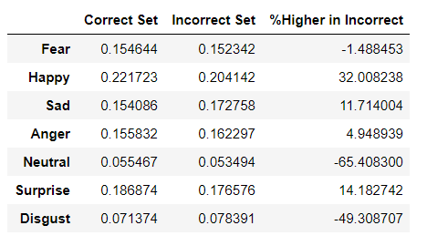
Average Emotional Score in Correctly v Incorrectly Classified Ratings
Notes:
The average normalized happiness score in reviews that our model failed to correctly classify was 32% higher than in reviews it correctly classified

